Slide 1
AgileSites 3.11 for WebCenter Sites 11g
Michele Sciabarra
michele@sciabarra.com
Sciabarra.com – Just Add Content

Slide 2
WebCenter Sites Architecture
A collection of nice diagrams

Slide 3
The Hidden Secrets of the Zen Master
What you always asked about it and no-one told you

Slide 4
The 3 Best Kept Secrets of WebCenter Sites
It is all about cache and publishing
Content Model is the king
If you start doing smart things in templates, you are doomed

Slide 5
It is all about cache and publishing
Sites has a very complex content model stored in the database
Database access is inefficient (tens of queries for each asset)
Caching is absolutely critical to get a fast site
The number 1 error of devlopers is ignoring caching until it is too late
Publishing and caching are related
Cache must be invalidated only partially when publishing
Hence dependencies between assets and pagelet must be tracked
The number 2 error of developers is ignoring dependencies so the WHOLE cache must be invalidated after each publish

Slide 6
Content Model is the king
A CMS is good as long as it is easy to edit a site
Hence you need to design a website that is easy to edit
This does NOT translate in a web site that is easy to develop
The biggest complain of end user is that the site is awkward to edit
This is the result of database-like content model definition
It is wrong because it is inefficient and very hard to edit
The typical nightmare: a "relation asset"

Slide 7
Do not do SMART things in templates
Developer very often think that templates are simply JSP they can do whatever with it.
They are NOT:
Templates are cached:
you cannot pass parameters around
You cannot do complex calculation every time
Template must adapt to an easy (for the editor) Content Model
That makes the code often hard to write and complex
Complex (smart) code breaks all of it

Slide 8
4 noble truth about Sites
Sites is not a development environment
IT IS A WEM/CMS/ECM system

Slide 9
4 noble truths about Sites
Sites is not a development environment
Sites is not designed for developing applications
It is good for fast, cached content
It is bad for slow, dynamic web output

Slide 10
4 noble truths about Sites
Sites is not a development environment
Sites is not designed for developing applications
You should not do web applications with Sites
Because it is too constrained
Because it is too limited
Because it is not its job
Because there are better way doing it

Slide 11
4 noble truths about Sites
Sites is not a development environment
Sites is not designed for developing applications
You should not do web applications with Sites
Sites does not have good support for developing applications
In short it is a CMS, not something else
Did I mention you should not try to develop application with Sites?

Slide 12
Sites Rendering 1-2-3
The most important concepts to understand
when you design your content model and templates
for WebCenter Sites

Slide 13
Basic Terminology
Asset
All the content is an asset
It is publishabe;
Each asset has a type
Very roughly, a (simple) asset is a record in a table
Flex Assets
Have attributes
Can change their attribute set (definition)
Roughly they are a master-detail table set

Slide 14
Basic Terminology
Element
The underlying code executed by a Template
JSP mostly
Also XML and Groovy
It is NOT an asset – but can be part of an Asset
Template (and CSElement)
It is a (special) asset
It can render a (non executable) asset
They wraps Elements with metadata
It is executable
It is publishabe

Slide 15
CMS main concept
Separate content from presentation
Select an asset (content data)
c is the content type
cid is the content id
Select an element (presentation logic)
pagename is the Element
You always apply an element to an asset
So you need a pagename and a c+cid

Slide 16
Variables
C
CID
PAGENAME
SITE
RENDERMODE
Content Type
Content ID
Site Entry to render
The current site
The rendering mode (live, insite, preview)

Slide 17
The rendering process
It starts always with a Wrapper and c/cid
It will select an asset and a layout
You will apply different elements to different content on the road
Wrapper
Layout
TopNav
SideNav
Detail
Footer

Slide 18
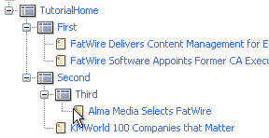
The Site Plan
Select your content type
c=Page
c=News
NOT ALWAYS you will render a Page asset to a full web page
Page
News

Slide 19
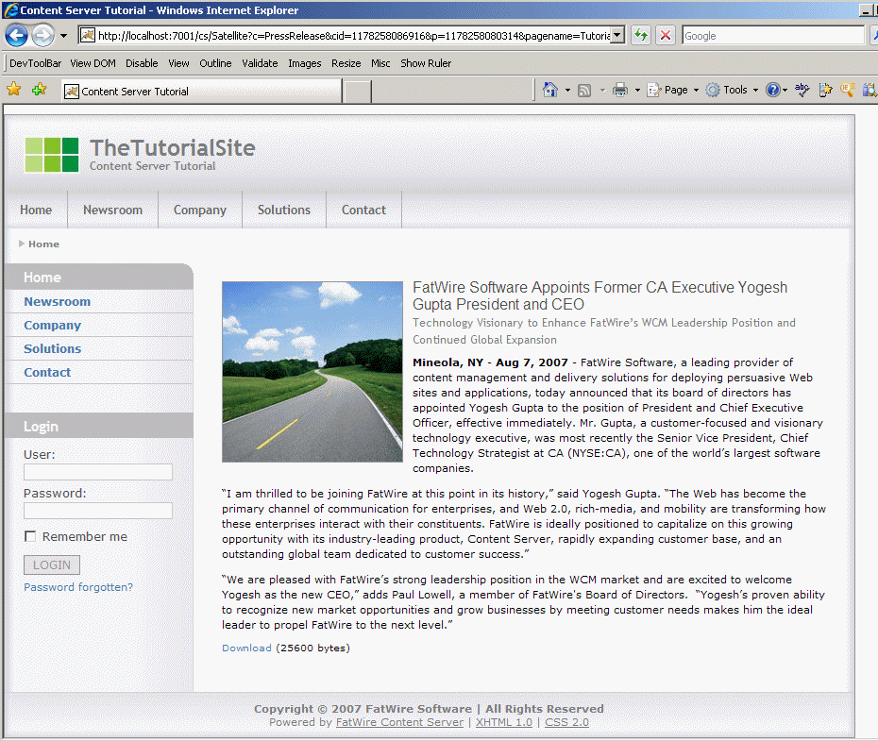
Render News
News/Detail
News/Layout with c=News
Call News/Detail
Call Image/Detail
Image/Detail

Slide 20
News/Layout
TopNav
Page/Link
Layouts render
TopNav
SideNav
Footer
Navigations consult siteplan for c/cid
Call Page/Link for the links
SideNav
Footer

Slide 21
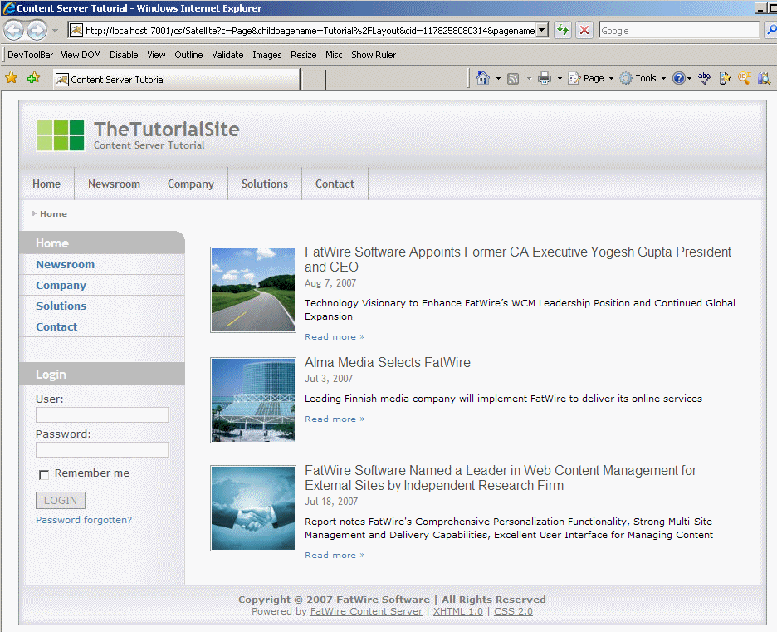
Render Page
Page/Detail
Page/Layout
Call
Page/Detail
For each children
Call News/Summary
News/Summary

Slide 22
Render Summary
Image/Summary
Call Image/Summary
Call News/Link
News/Link

Slide 23
Templates & CSElements
Page/Detail
Page/Link
News/Detail
News/Link
News/Summary
Image/Detail
Image/Summary
Wrapper
Page/Layout
News/Layout
TopNav
SideNav
Footer

Slide 24
Test Drive Sites UI and Development tools
Let's see how it works

Slide 25
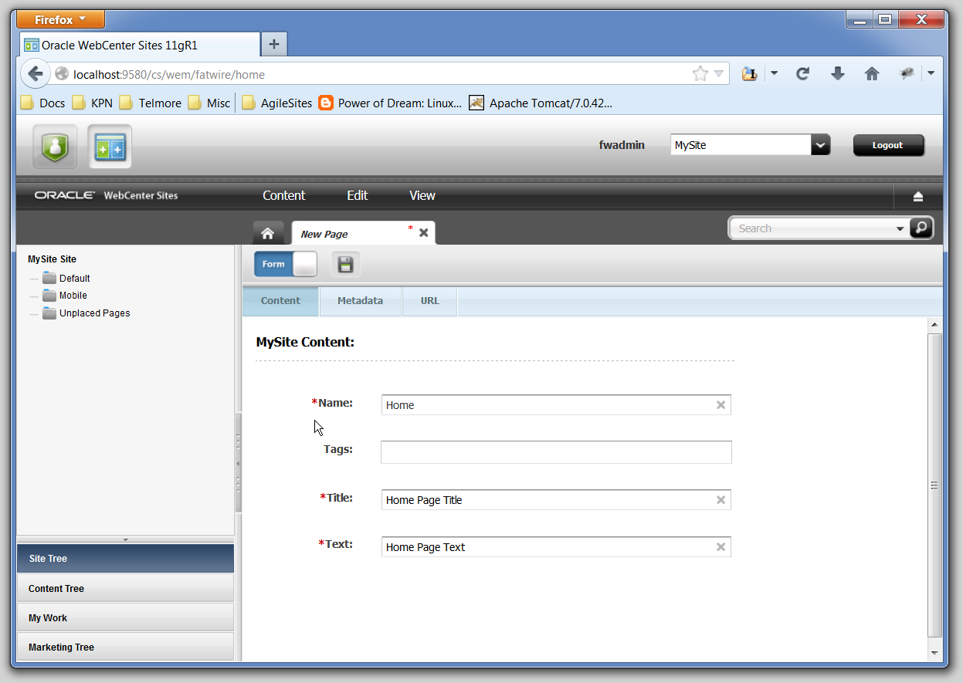
Contributor Interface - Form

Slide 26
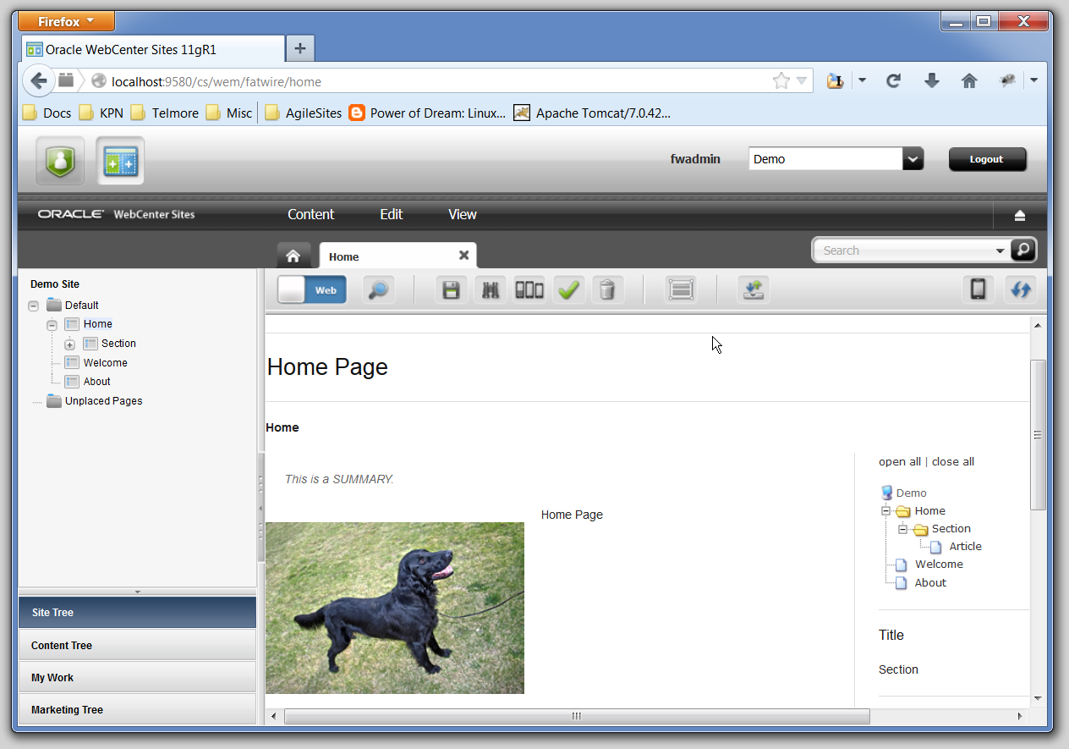
Contributor Interface - Visual

Slide 27
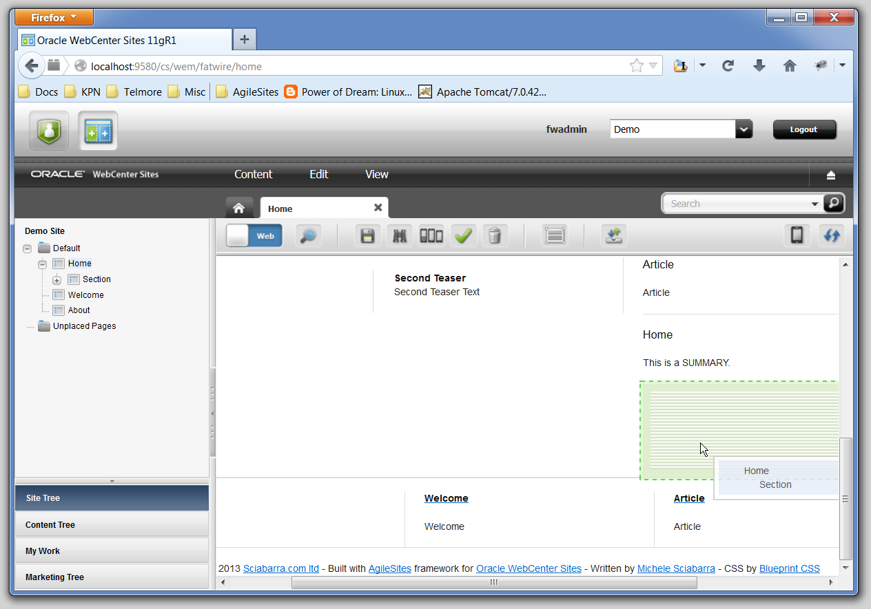
Contributor Interface - Slot

Slide 28
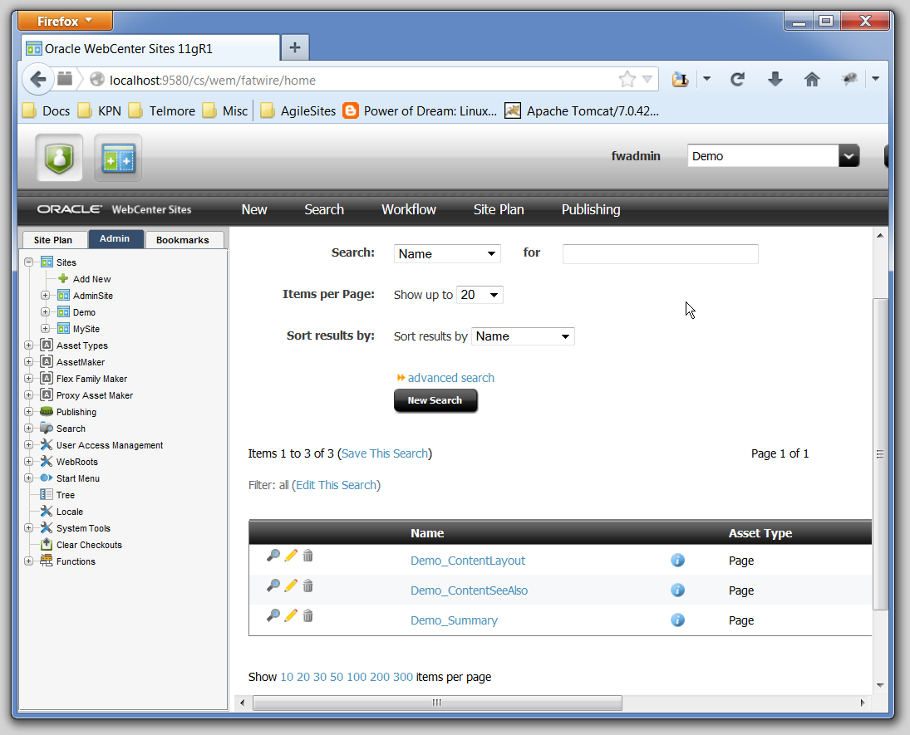
Admin Interface

Slide 29
Prerequisites for AgileSites 3.11
IMPORTANT:
Install JAVA 1.7 JDK (Sites 11g does not work with Java 8)
ensure JAVA_HOME points to the Jdk 1.7
Install sbt
http://www.scala-sbt.org
Quick test: start SBT and check you have java 1.7 with
eval sys.props("java.version")

Slide 30
Install Sites 11g & AgileSites 3.11
Get the starter.zip from TODO/started.zip
Unzip it in a directory of your choice
Install Sites
sitesDownload <username> <password>
sitesInstall
Control sites with those commands:
server start
server status
server stop

Slide 31
Create a new website
Decide for a name: e.g. Starter
Edit the agilesites.properties
Add
sites.focus=Starter

Slide 32
ABC of Element Development
Time to start getting hands dirty

Slide 33
Sites Elements
You do development in Sites using Java Server Pages or Groovy
JavaServer Pages
Sites has a proprietary tag library
Output is Buffered
Output is the Cached
Groovy (+AgileSites)
Groovy is 99% like Java (except it is slower)
It does not matter because in Sites everything should be cached
http://groovy.codehaus.org/Differences+from+Java
Plus a number of nice extensions

Slide 34
Templates & CSElement
It is an Asset holding an Element
It is Publishable
It contains meta data
It is UNCACHED
Use for rendering logic that embed html in the caller
In is an Asset holding an Element
It is Publishable
It contains meta data
It is CACHED
Use for rendering logic that create separate Pagelets

Slide 35
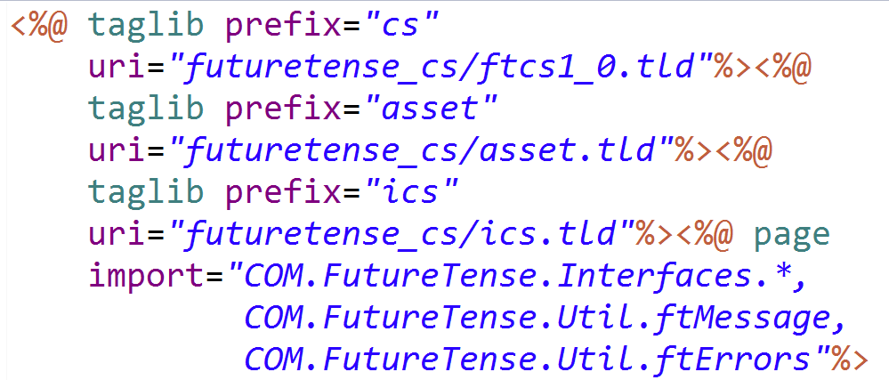
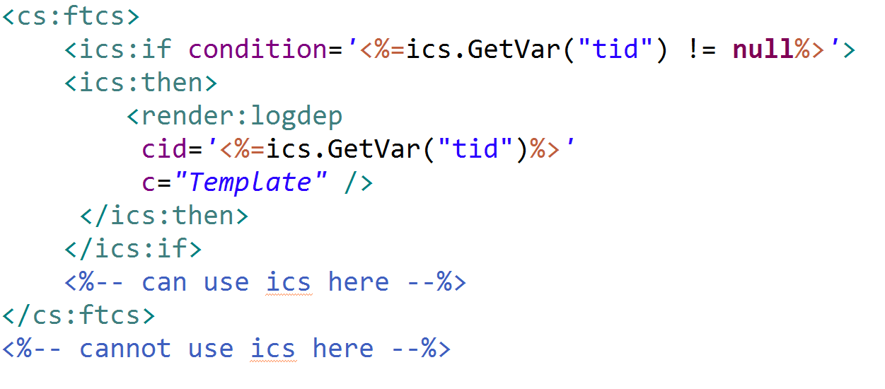
A generic JSP
Mandatory imports
Where your code should go

Slide 36
The ubitiquous ICS
ICS is the Interface to Content Server
A facade used for almost everything
Must be uses inside a <cs:ftcs> block
Content Server is the internal name of the product
Future Tense is the original developer of Sites
It contains:
Variables (Strings)
Lists (tables, actually)
Object (arbitrary pojos)

Slide 37
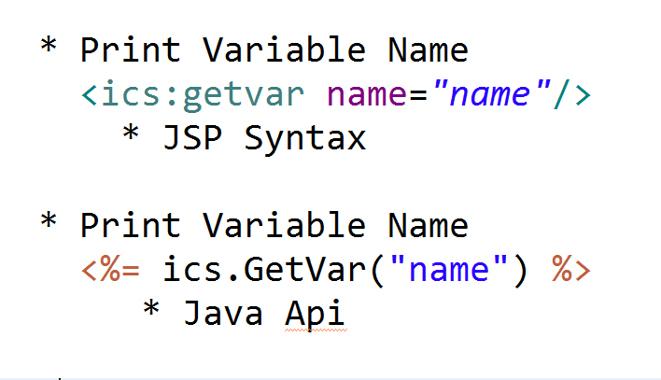
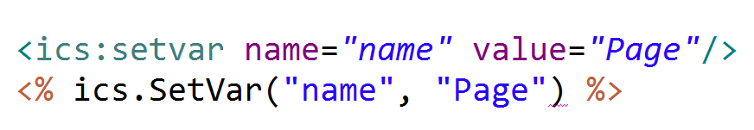
Variables in Sites

Slide 38
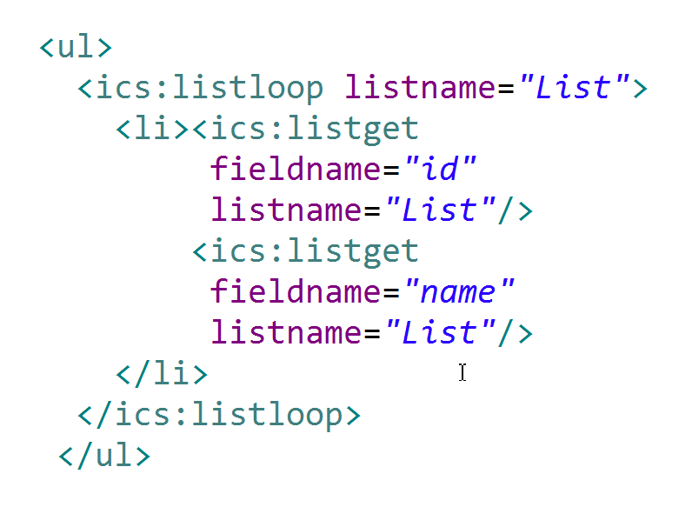
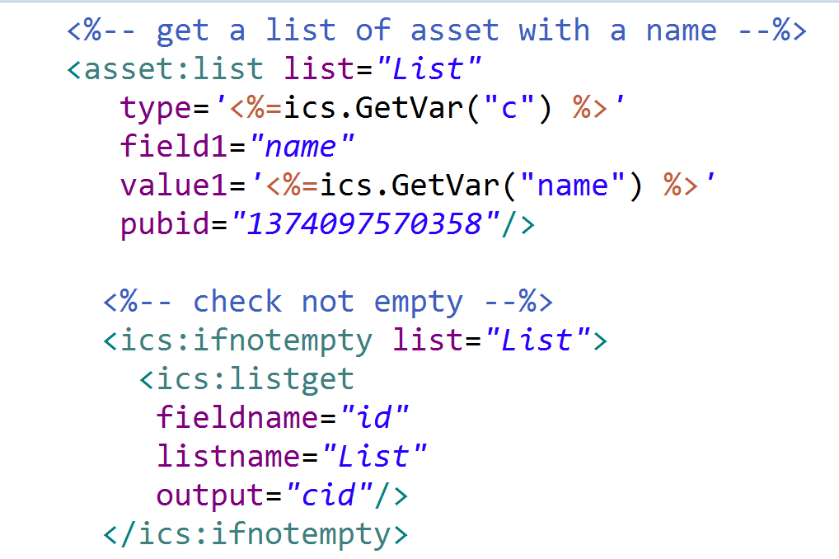
Lists in Sites
Get a list of assets
Loop a list
DO NOT DO THIS! ONLY A SAMPLE
List Output

Slide 39
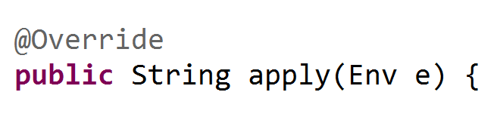
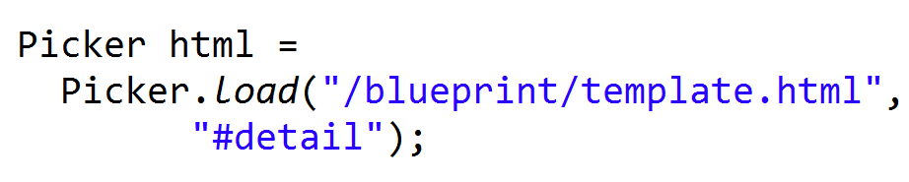
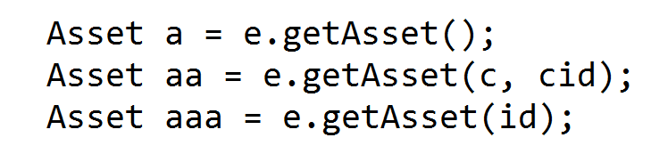
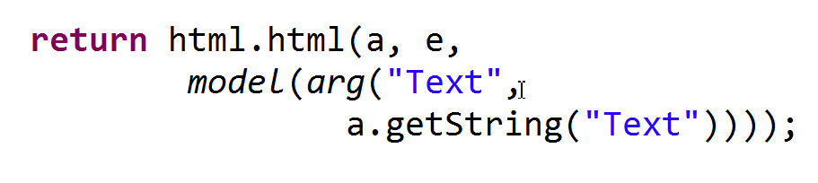
AgileSites ABC
Env:
Assets:
Picker
Model

Slide 40
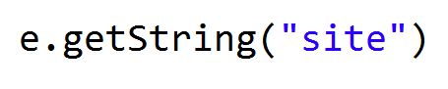
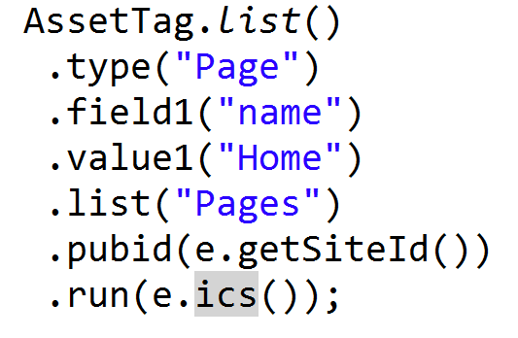
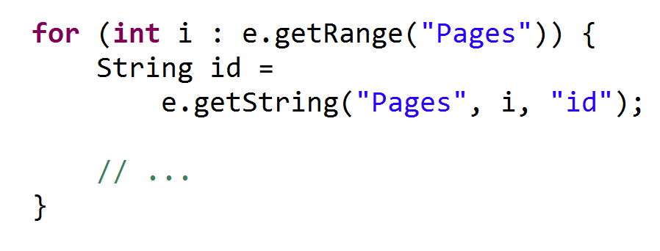
AgileSites Vars & Lists
Variables
List
Access to tags

Slide 41
Lab: List and Variables
Assignment: Give defaults to the Wrapper
if set c is null set it to Page
If name is null set it to Home
If cid is null and name is not
Use the variable name to locate an asset of type c and given name and assign to cid
Familiarize with basic components of Sites development
You should be able to load a page by name and the home page by default calling
http://localhost:8180 /cs/Satellite?pagename=Telmore/Telmore_Wrapper

Slide 42
Beginning Content Modelling
Lean how to create your content model

Slide 43
Hierarchy
Type:
Page
PageDefinition
Subtype: Home
PageAttribute
Attribute:
Text
Site_Home
Attr Types
Attribute:
Title
Site_Text
Site_Title

Slide 44
Attributes
Attributes can be
single
multiple
AttributeEditors
Stock
Custom
Attributes have different types
String
Text (long string)
Image
Asset

Slide 45
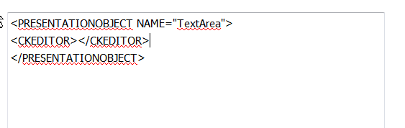
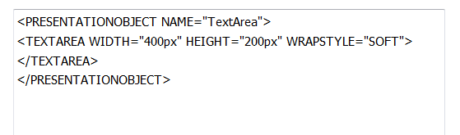
Attribute Editors
Attribute editors define editing options for attributes
TEXTAREA
CKEDITOR
Defined with an XML file
Unfortunately
Documented in developer manual

Slide 46
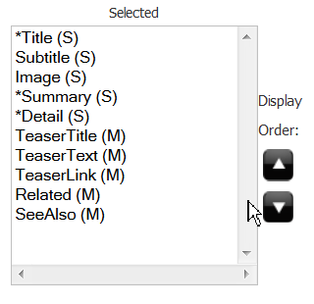
Definitions
Definitions
A set of Attributes
Used by contents to define their attributes

Slide 47
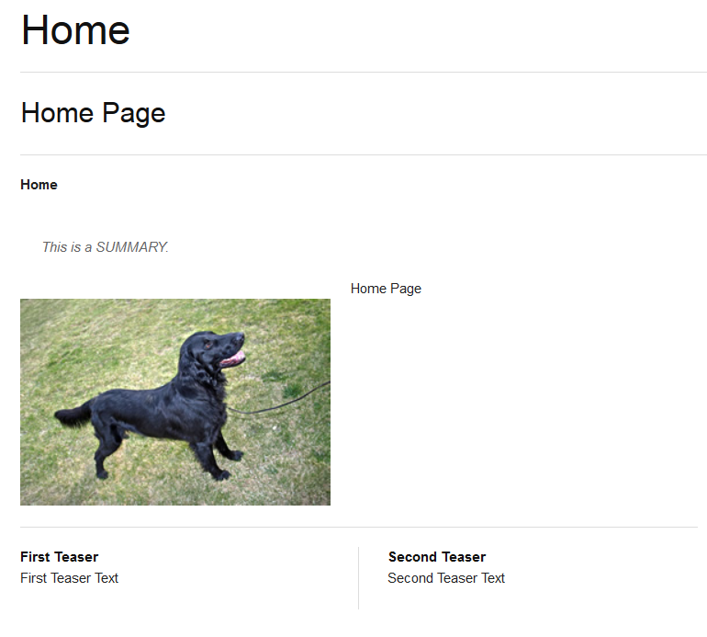
Attributes
Title
Subtitle
Sumary
Image
Detail
TeaserText
TeaserTitle

Slide 48
Lab: Create Attributes
Define 2 attribute editors
CKEDITOR
TEXTAREA
Define attributes
Subtitle: single, string,
Summary: text, single TEXTAREA
Detail: text, single CKEDITOR
Image: single, blob
TeaserTitle: multiple, string
TeaserText: multiple, text
Related: asset, multiple
SeeAlso: asset:, multiple
Place them in the Content definition
Objective:
Learn about attributes, definitions and attribute editors
You will create all is needed to render a whole page

Slide 49
Extracting attributes
Let's start adding the content

Slide 50
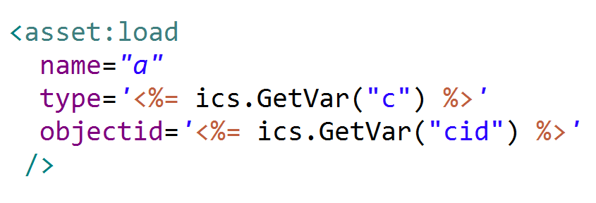
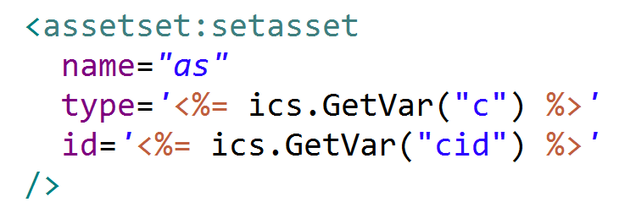
Loading an asset
Load the asset "head"
Load the attibutes
Load the asset:
No args => current
String c
Long cid
Id id

Slide 51
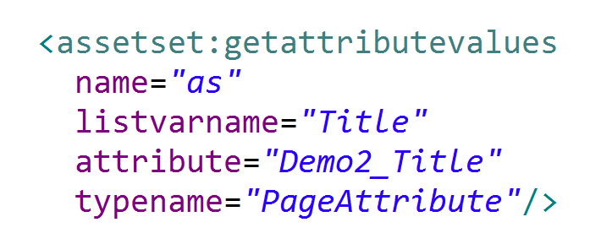
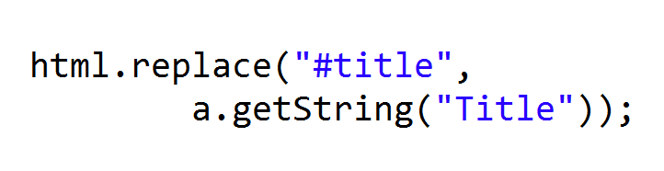
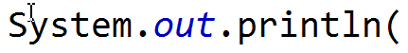
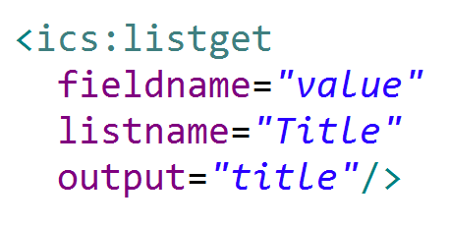
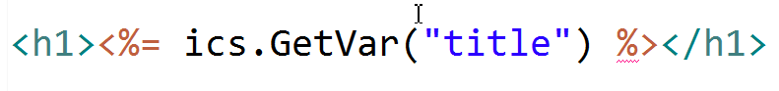
Reading single attribute
Load the attributes
Extract the value
Print
Get the attribute and place in the mockup

Slide 52
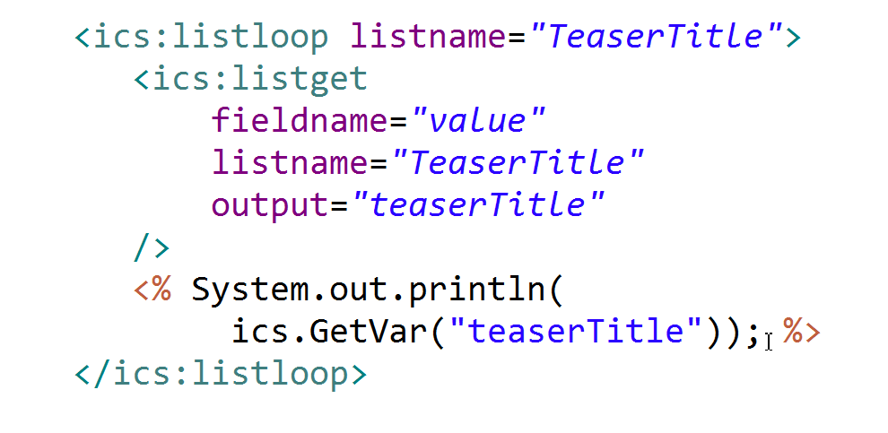
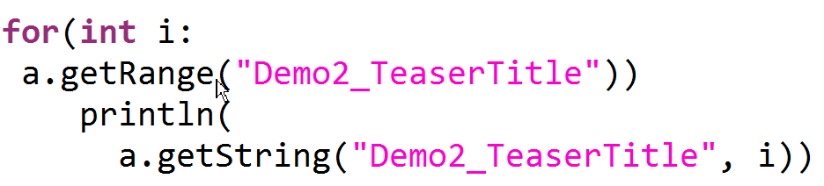
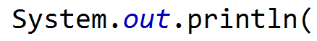
Reading multiple attributes
Looping multiple attributes
Looping multiple attributes

Slide 53
Lab: reading attributes
Extract attributes
Load the asset
Print a single attribute Title in the terminal
Print a sequence of multiple attributes in the terminal
Objective: learn how to load assets and extract attributes
You will end up seeing the attributes in the terminal

Slide 54
Placing Attributes in a mockup
From static html to a dynamic website

Slide 55
The fine art of HTML cutting
The common part of
web page
Wrapper
The specific part of each layout
Layout

Slide 56
Inserting content in JSP
Cut and paste the html
In the Wrapper
<htm>…<body><div id="content"> <ICS:CALLELEMENT>
</div></body></html>
In the ContentLayout
everything inside the div#content
I assume you familiar with jQuery…
Output
<ics:getvar name="var"/>
<ics:listget list="List" field="value"/>

Slide 57
Mockup in Java with Picker
Pick the html
Picker p = Picker.load("/blueprint/template.html")
Moustache
{{Attribute}}
Replacements
p.replace("#location", a.getString("Value"))

Slide 58
Lab: use a mockup
Use the blueprint mockup
Fix the Wrapper adding the HTML from the template.html
Fix the CSS/JS inclusions too
Fix the Layout adding the HTML from the template.html
Objective:
Use an html mockup to place your HTML

Slide 59
Rendering Images
How to render a blob

Slide 60
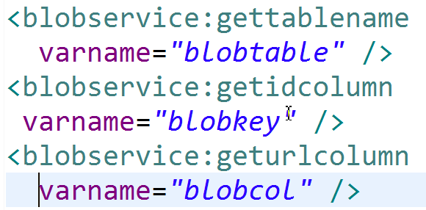
Url Parameters
BlobService
Generated URL
http://localhost:9580 /cs/Satellite ?blobcol=urldata &blobkey=id &blobtable=MungoBlobs &blobwhere=1374097575433 &ssbinary=true

Slide 61
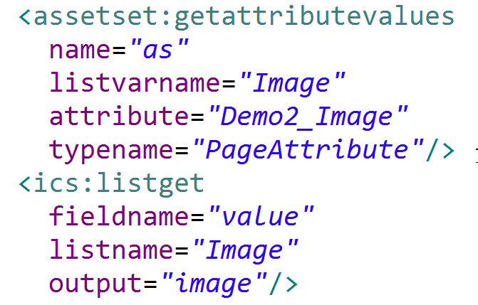
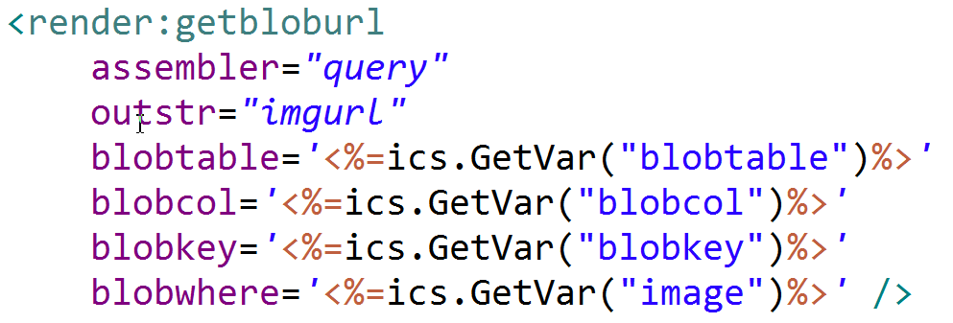
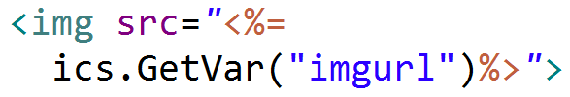
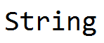
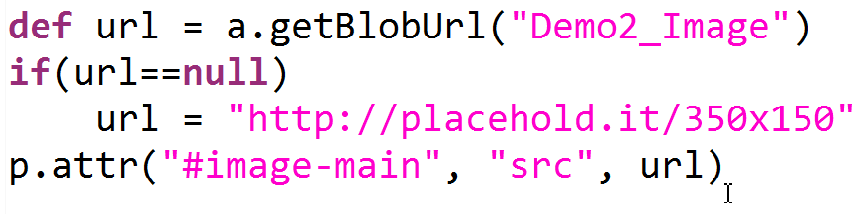
Render the image
Get id of the image
Get and use Image URL
Java:

Slide 62
Lab: rendering an image
Save an image in the Image field of a Page
Get parameters with blobservice
Load the id of the image
Render the image with getbloburl
At the end of the lab you will see an upload image rendered in the Page

Slide 63
Rendering Links
The core of the web at your fingertips

Slide 64
What is a link in Sites anyway?
You always link to ASSETS
The linked asset will start the rendering
So you need c,cid and pagename
Best Practice! Pagename is ALWAYS the same
Generating links with different pagenames has many problems
Create a Site Entry named Entry to use always that points to the Wrapper
Demo2/Entry -> Demo2/Demo2_Wrapper

Slide 65
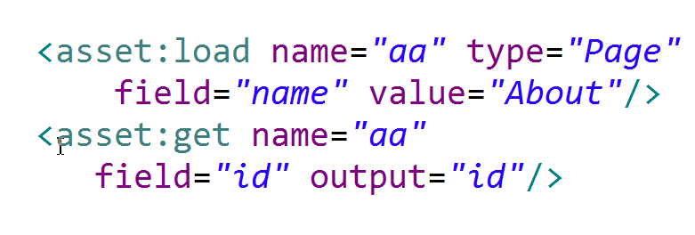
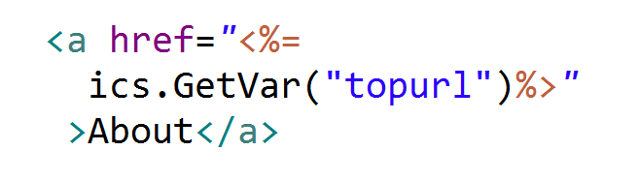
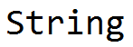
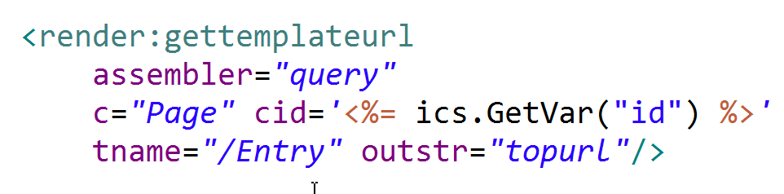
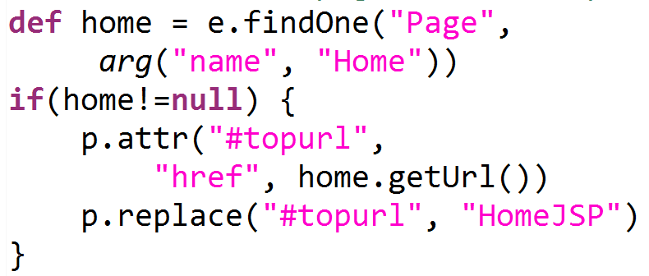
Generate a link
Load the target asset
Get a Link
Render the Link
Java

Slide 66
Lab: rendering a link
Load the related asset
Get the url of the related asset
Render the url
At the end of the lab you will learn how to create a link to another page and implement it

Slide 67
Rendering Inner elements
Nesting is the key for leveraging the content model

Slide 68
A composite view
Not everything that is needed to render a web page is an attribute of a single asset
Very often you have a set of assets that refers each other
The golden rule of Sites template development
In a template render only ONE asset
If you find another asset. change the current asset (c/cid) and call another template

Slide 69
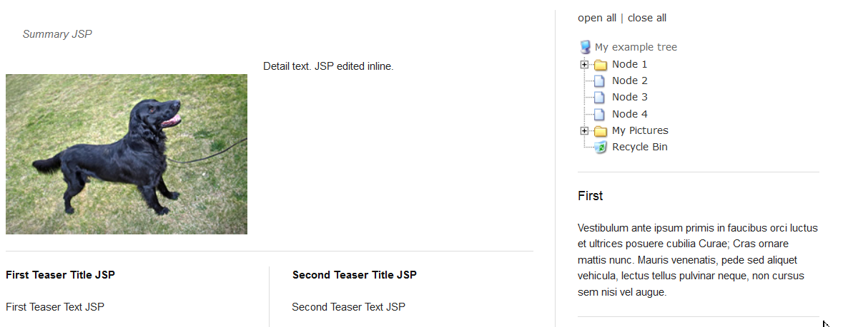
Spot the difference
Fields of a different asset – need to call a different template
Fields of the same asset – no need to change template

Slide 70
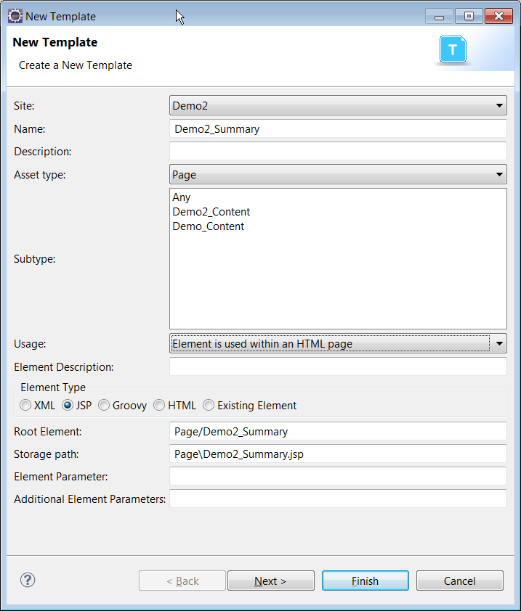
Need a new template Summary
Create a new template
Demo2_Summary
For Page
Element used within an HTML page
The template renders a summary
Code is similar to the Layout code
Actually 2, JSP and Groovy versions

Slide 71
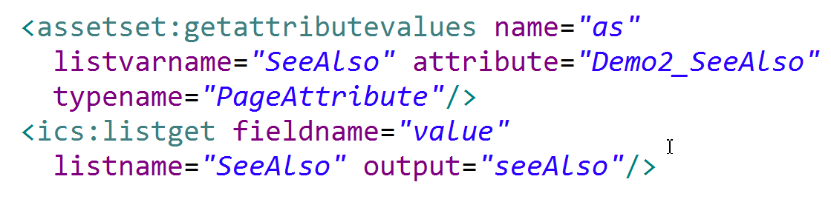
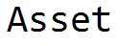
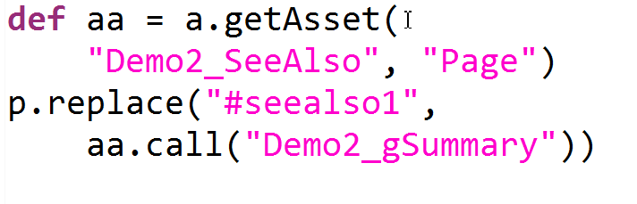

Calltemplate
Get the id
Call the template
Java Version

Slide 72
Lab: rendering blocks
Add a SeeAlso attribute and link the 2 pages
Create a Summary for Page Template and render it
Call the summary with calltemplate
At the end you will render the summary with a separate template

Slide 73
Insite editing
Use the site preview for in-place editing

Slide 74




Insite editing
Insite Edit
Editors, default value
Java

Slide 75
Lab: insite editing
Change the Title to editable
Change the TeaserTitle to editable
In this lab you will enable insite editing for a single asset and a multiple asset

Slide 76
Slot
Drag and drop other assets in the current page

Slide 77



Define a slot
Non Empty Slot
Empty Slot
Groovy:

Slide 78



Empty Slot & List Issue
Collect all the ids in an array fixed size
Distinguish empty from non empty

Slide 79
Lab: Slot
Define 3 slots for SeeAlso
Handle the empty and non-empty case
Copy to a List
A case for null
A case for not null
In this lab you will create slots for drag-n-drop of content

Slide 80
Rendering navigations
Consunlting the SitePlan for rendering a breadcrump

Slide 81
SitePlan is tricky to use
SitePlanTree
Page
Page
Page

Slide 82

SitePlan
Navigating the siteplan
Get the nodeid first
Siteplan functions
Path
Children
Whole tree
Others (check siteplan:*)
Path
getsitenode
chidren

Slide 83




Creating a breadcrump
Load the nodeId
Reversed, cleaned path
The path
Current page

Slide 84

The Link callelement

Slide 85


The Java way (all-in-one)

Slide 86
Lab: rendering navigations
Create a Link cselement to render a link Walk the siteplan
Get the path (reversed and filtered)
Print the breadcrump invoking the Link cselement
After completing the lab you will have a nice, shiny breadcrump in your site

Slide 87
Cache & Dependencies
Speed up your WebCenter SIte

Slide 88
Multiple cache in Sites

Slide 89



Satellite Page(let) and blob Cache

Slide 90



Sites Page(let) cache

Slide 91



Asset (pojo) Cache

Slide 92



ResultSet (table) cache

Slide 93



Dependencies (the easy part)

Slide 94



Checking dependencies
Quiz:
From where they are coming

Slide 95

Answer

Slide 96



Dependencies (the hard part)

Slide 97

Lab: Cache & Dependencies
Think about this:
You have a 100.000 pages site
Each page have this (complete) tree
What would you do?
Open discussion lab

Slide 98
Flex Families
More advanced content modelling

Slide 99


Creating a new Flex Family
Create a new flex family
Convention: use the site name prefix
Demo_A Demo_PD Demo_CD Demo_F for developers
Demo2_Category Demo2_Article for users

Slide 100

Additional Parent and Content
Articles grouped in Categories
Video and Images grouped in Galleries
One flex family is enough!
Do not create one flex family for each new content!

Slide 101


Enabling the types in the site

Slide 102

Create initial start menu…
For developer Asset, generally yes
For user Asset better not
You will refine better later

Slide 103


You have then now in Admin UI

